Slide 1
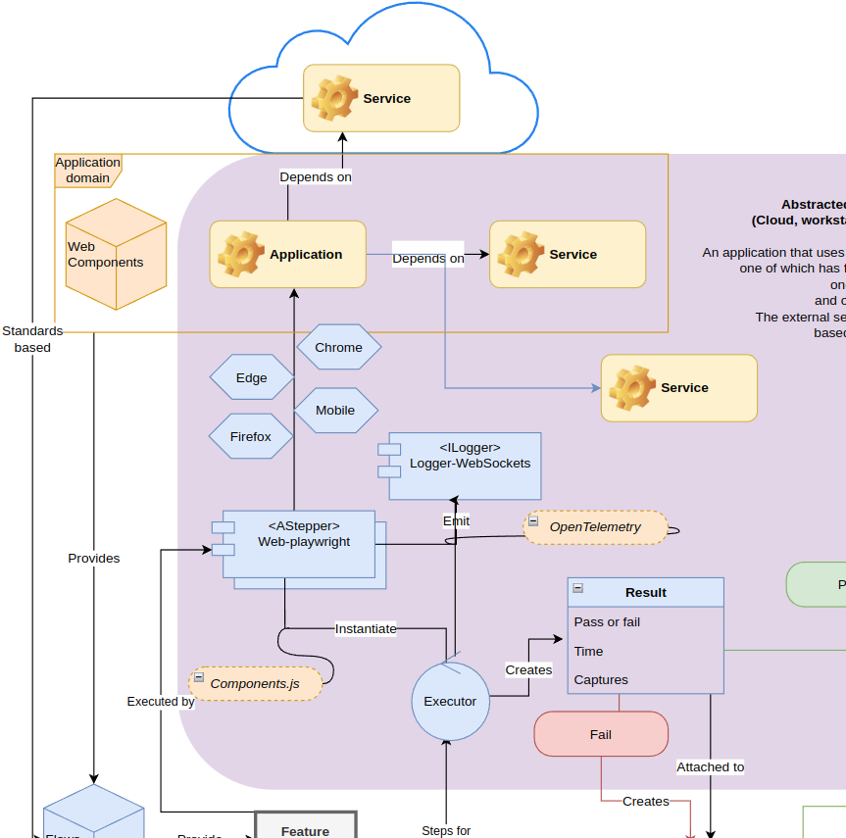
Haibun End to end test driven development in abstracted environments
Planning 2023 July, 2023
Overview diagram

Slide 2
Current state
Define plain language tests, reusable flows for diverse environments, minimum of low level code in test repo
Align with business definition, documentation
Modular approach to use the most appropriate combination of low-level implementations
Web-playwright, web-accessibility, storage-azure, etc
Minimum of third-party code
Version tests, modules, implementation, pipeline together (IaC)
Cloud and pipeline support
Generate xunit results (dashboards)
support local, memory, or Azure storage
Automated, saved reviews
Support expiration schemes for saved reviews
Review dashboards (wip)

Slide 3
Planned enhancements
Refactor execution
Simplify single instance test
Horizontal scaling
Deep load tests
Run statements on action type
Use consistent JSON-LD data for symbolic representation
Build toward knowledge graph for applications
Normalize statements
Add simple flow logic
Editor extension
Syntax per configured modules
Interactive test development / browser generated tests
Simplify flow components`
Cloud based workflow
Define system components at a vendor and implementation neutral level
Failed tests automatically create issues
AI enabled workflow
Generate application components
Generative bot for end user or dev support
Use endpoints and symbolic representation as gateways to prevent hallucination

Slide 4
Application timeline (in conjunction with applied dev)
Dashboard integration: July
Load testing: August
Webparts integration (research), pipeline workflow: September
Mapping / internal knowledge graph: October

